Slide 1


WELCOME
To our Presentation

Slide 2
Presented by-
MD Musfiq Rahman 19202103329
MD Aminul Islam 19202103334
Omme Habiba 19202103338

Slide 3

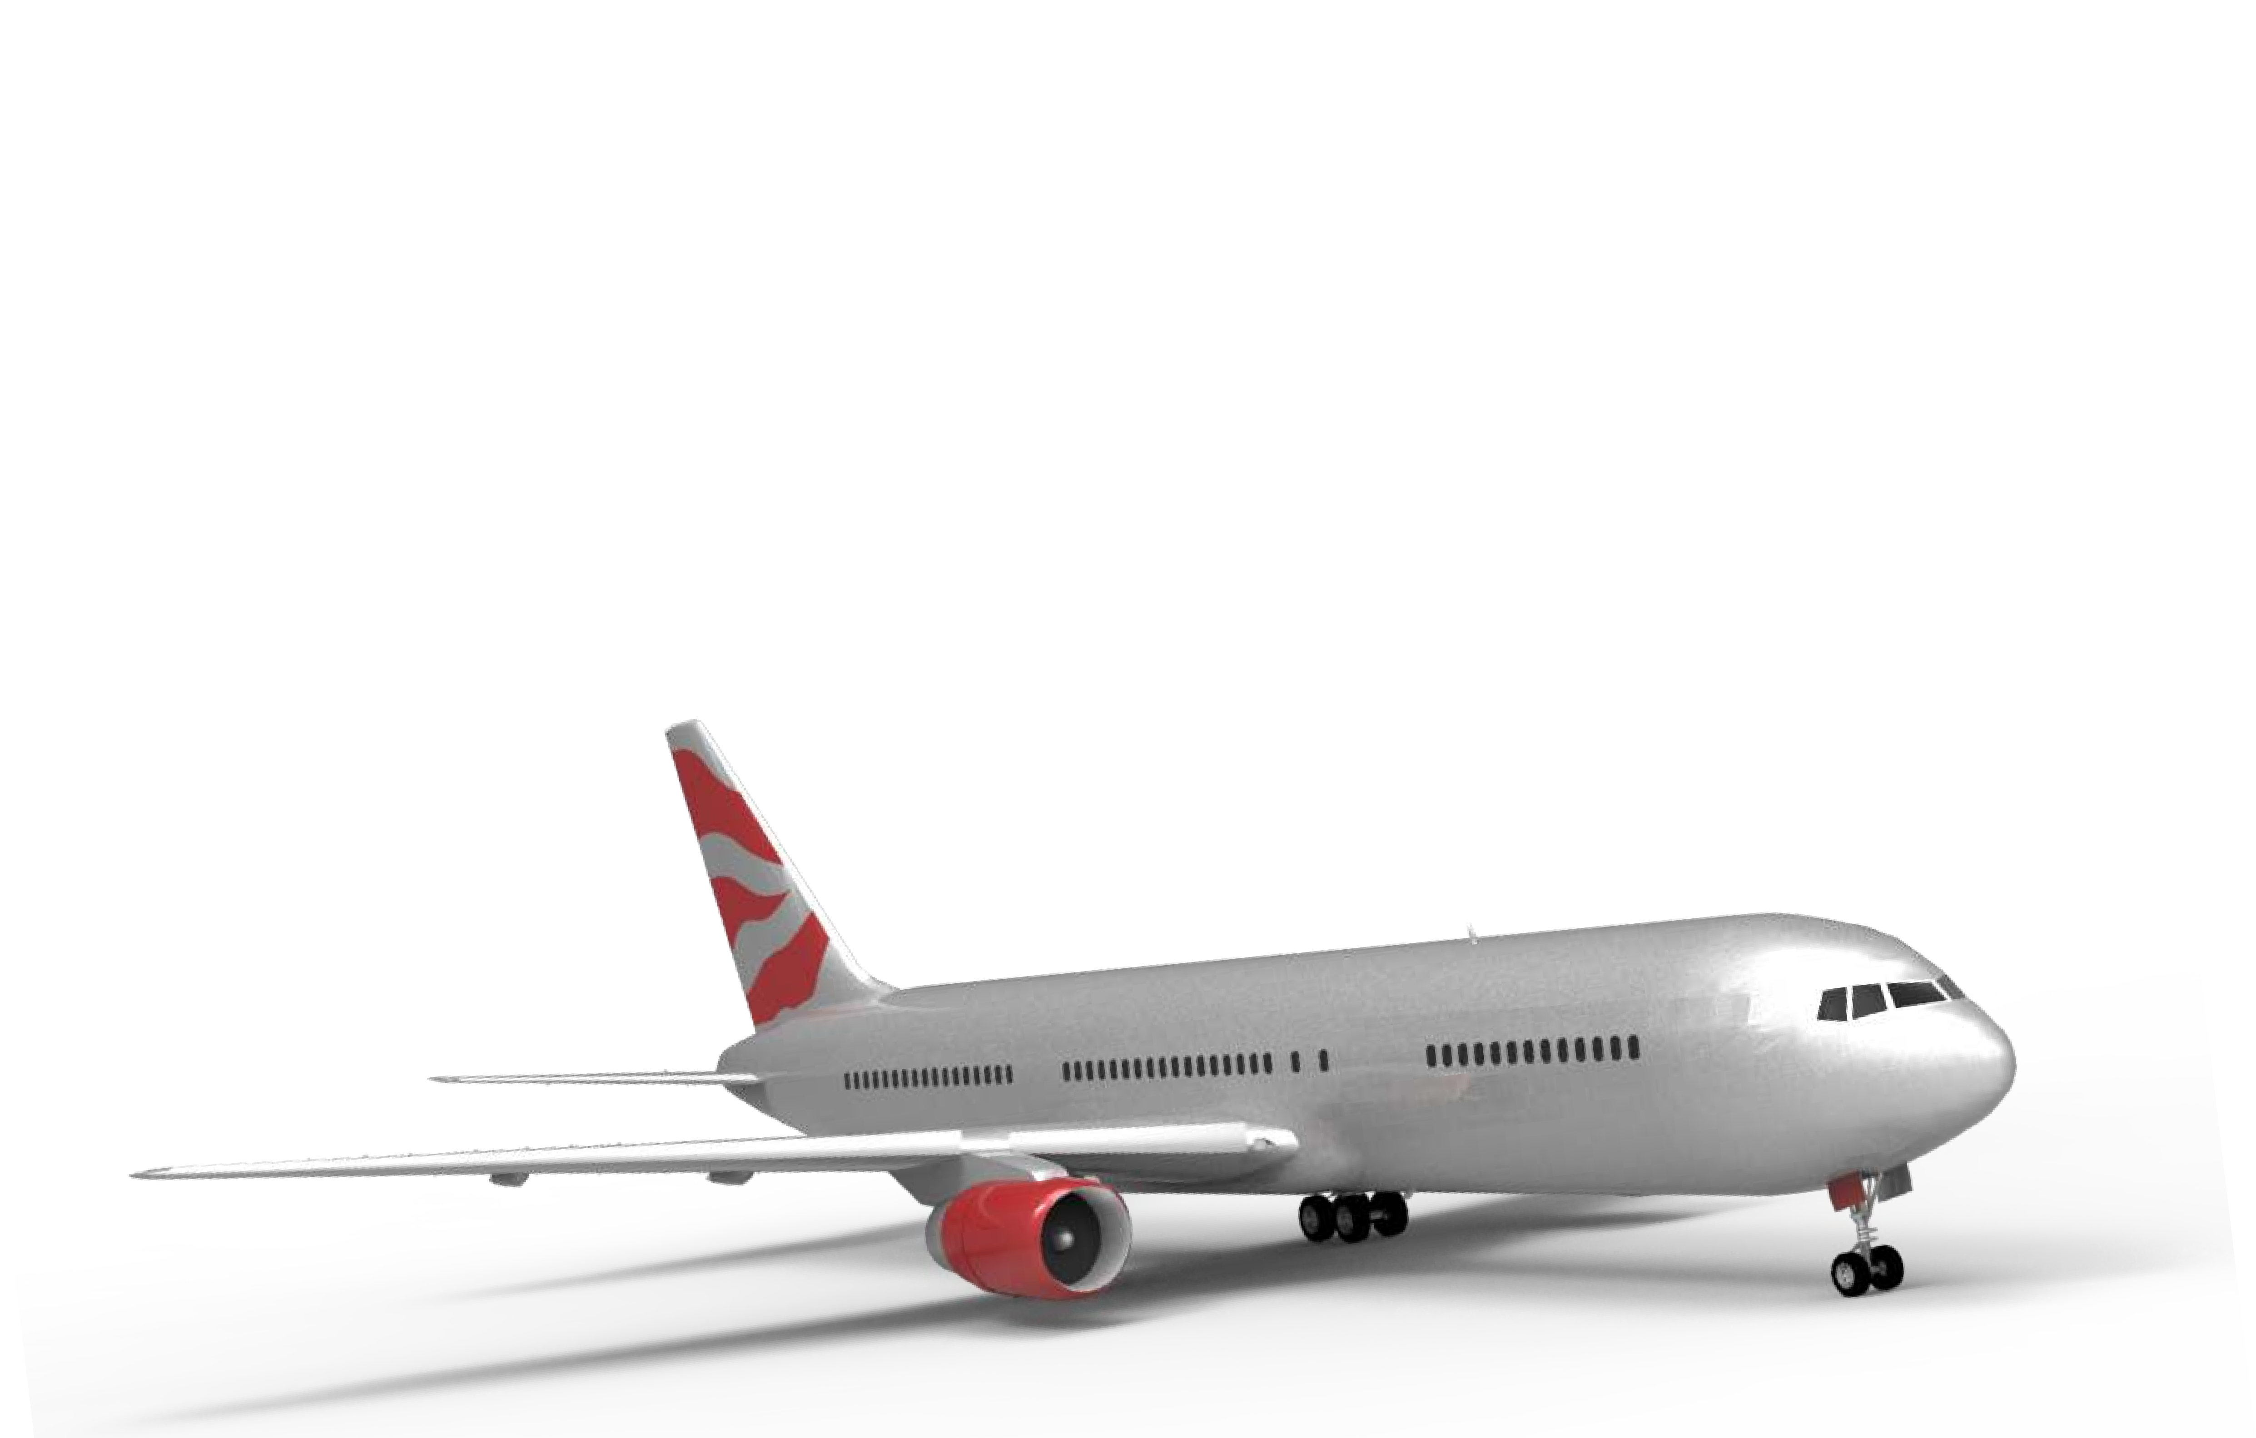
Airline
ManagementSystem

Slide 4

Introduction
Purpose of this project
This project on Airline Management System is the automation of the registration process of the airline's system. The system provides information like passenger’s information, flight information, list of all passengers,etc. This system is designed to solve problems related to journey by air. Electronically handling of flight’s record enhances the accuracy, flexibility, reliability and removes the human’s error.
Importance of this project
Flight Reservation System plays an important role to airlines companies to maximize sales of tickets, increase the number of valuable customers, and also improve the brand image of the company. In this modern era of globalization, most travellers use ﬂight as a means of transport. They want a travel arrangement from which all the related work can be done easily. So such a system is very helpful in this case.

Slide 5

Achievements
The system is designed to achieve the following:
* Create an online system for customers to view all domestic ﬂights.
* Create an online system for customers to view domestic ﬂight schedule and their ﬂight rates.
* Enable online ﬂight reservations.
* Makes available the number of ﬂights operated by an airline.
* Maintain a robust database for ﬂight information management.

Slide 6

Objective
The main objective of the Airlines Reservation System is to manage the details of Airlines Ticket, Flights, Customer, Booking, Venders. It manages all the information about Airlines Ticket, Bookings, Venders, Airlines Ticket.
The main objective of the Airlines Reservation System is to manage the details of Airlines Ticket, Flights, Customer, Booking, Venders. It manages all the information about Airlines Ticket, Bookings, Venders, Airlines Ticket. It is a system in which information about flight schedules, their availability and other connected information and also services about the airlines which helps in booking or issuing the tickets to the customers through which airline inventory is maintained, reservations can be made.

Slide 7
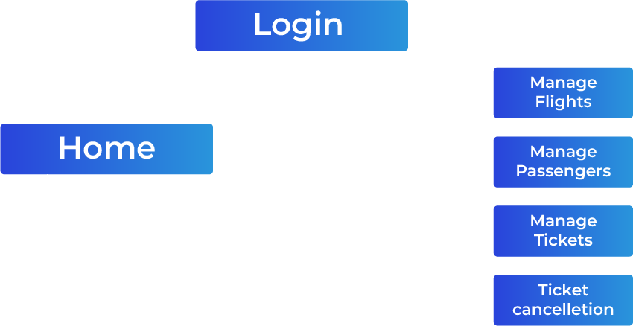
System Requirements
Processor : Preferably 3. 0 GHz or Greater.
RAM : 4 GB or Greater.
Di sk space : 20 GB or more.
Diagram

Slide 8
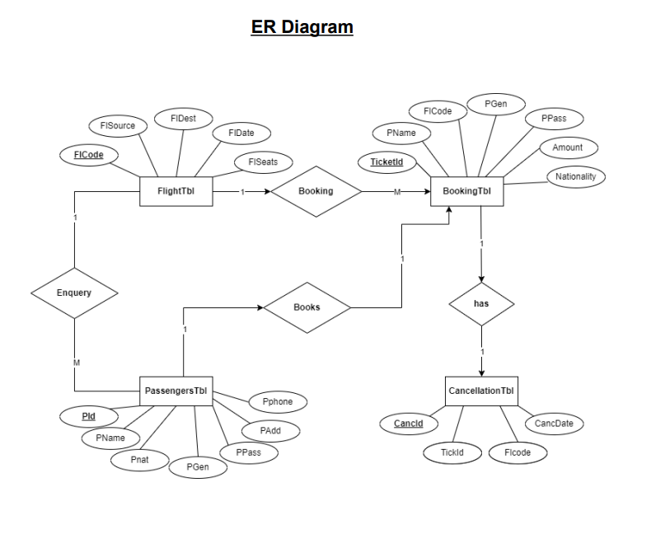

Slide 9
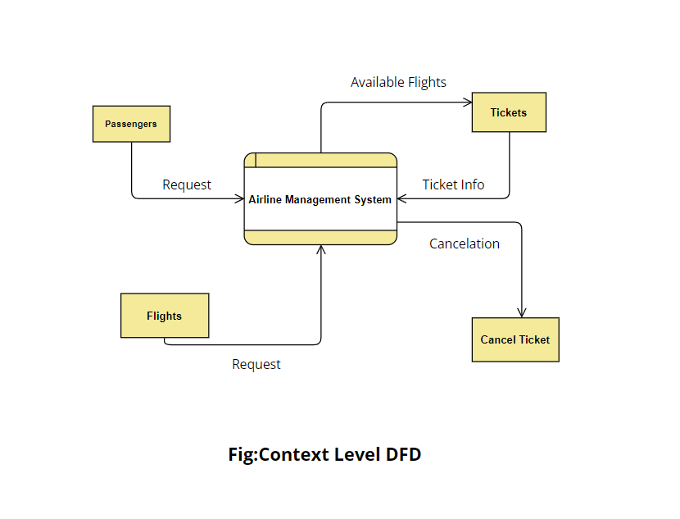

Slide 10
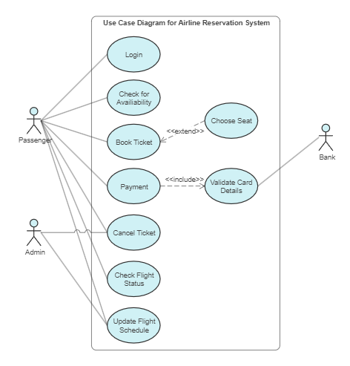

Slide 11

Features of the project
User login.
Traveling destination.
Flight Schueduling.
View flight schedule.
Ticket reservation.
Cancel reservation.

Slide 12

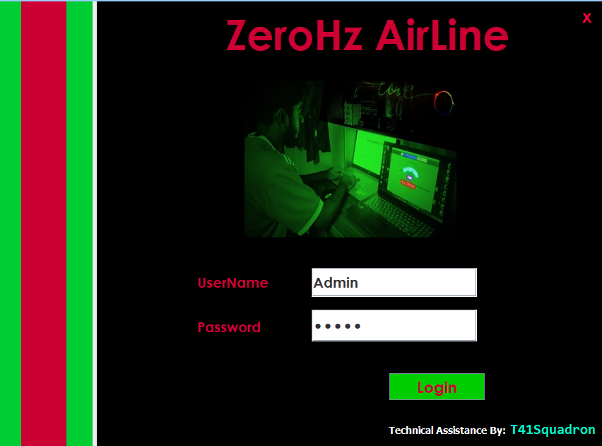
Figures
Login Page

Slide 13
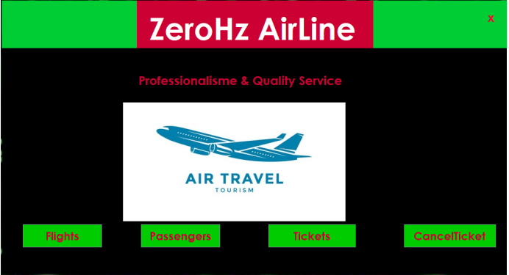
Home Page

Slide 14
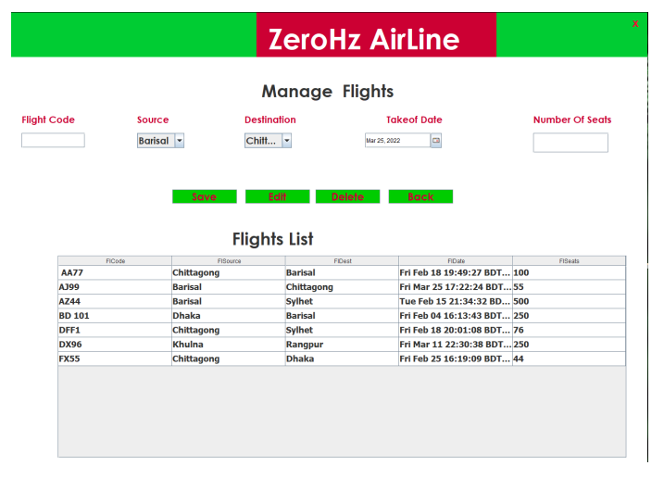
Flight Module

Slide 15
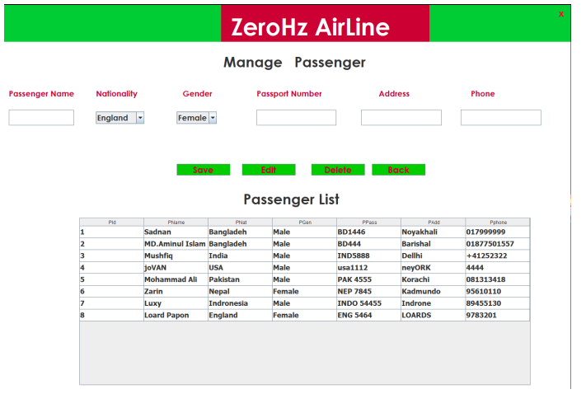
Passenger Module

Slide 16
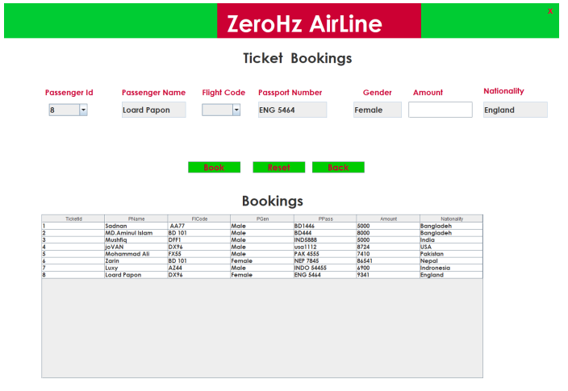
Ticket booking module

Slide 17
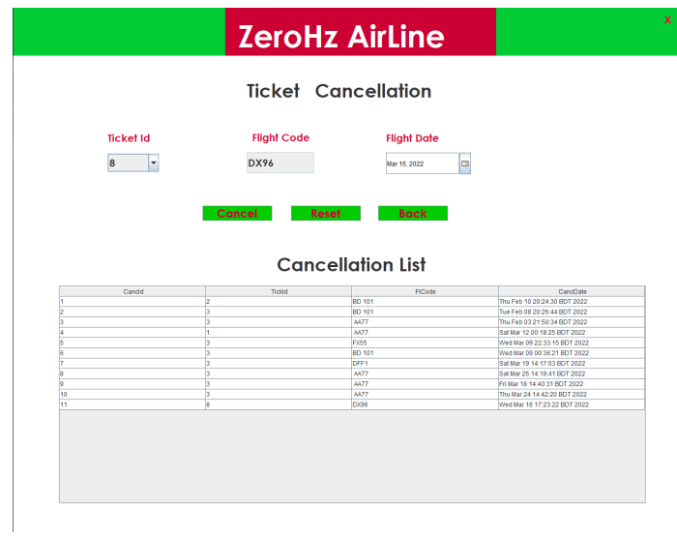
Ticket Cancellation

Slide 18

Conclusion
This project has guided our path through various aspects of computer science where developing online applications plays a major role. This software package “Airline Management System” provides convenient online uploading of the report from the executive and viewing that report by the managing director in an online fashion. To input the data in a highly validated manner and generate the different reports, involves a complex process that was being done in a based manner. This package is designed and developed in a compact manner, which is ready to meet the user’s specification and to serve them in an effective as well as in an enhanced way.

Slide 19
Thank you

